Slide 1
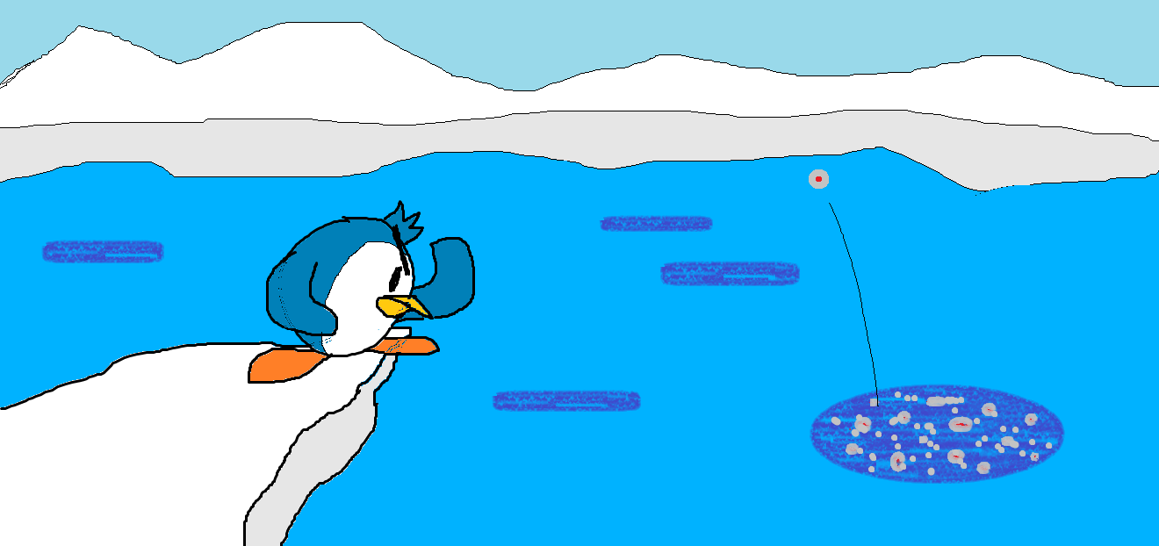
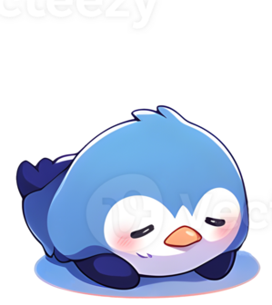

Seal Slap
Seal Slap
William Durfee (Mult 150)

Slide 2
CONCEPT, RULES, & REQUIREMENTS
CONCEPT, RULES, & REQUIREMENTS

Slide 3
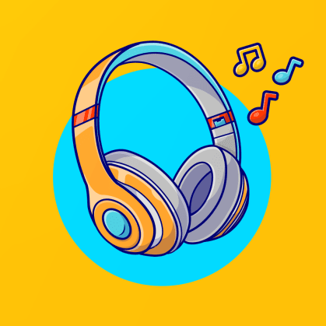
Seal Slap is…
A rhythm game inspired by the Rhythm Heaven series.
The game will require only one button to play.
It will challenge player’s reaction time as they time their button presses to the beat of the music.

Slide 4
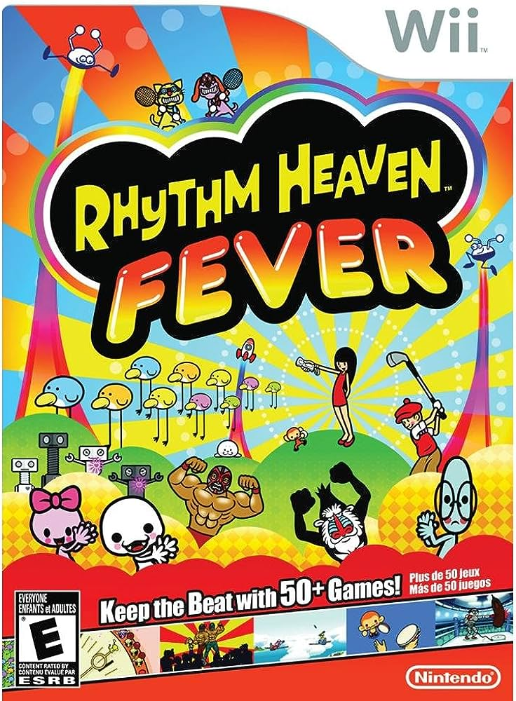
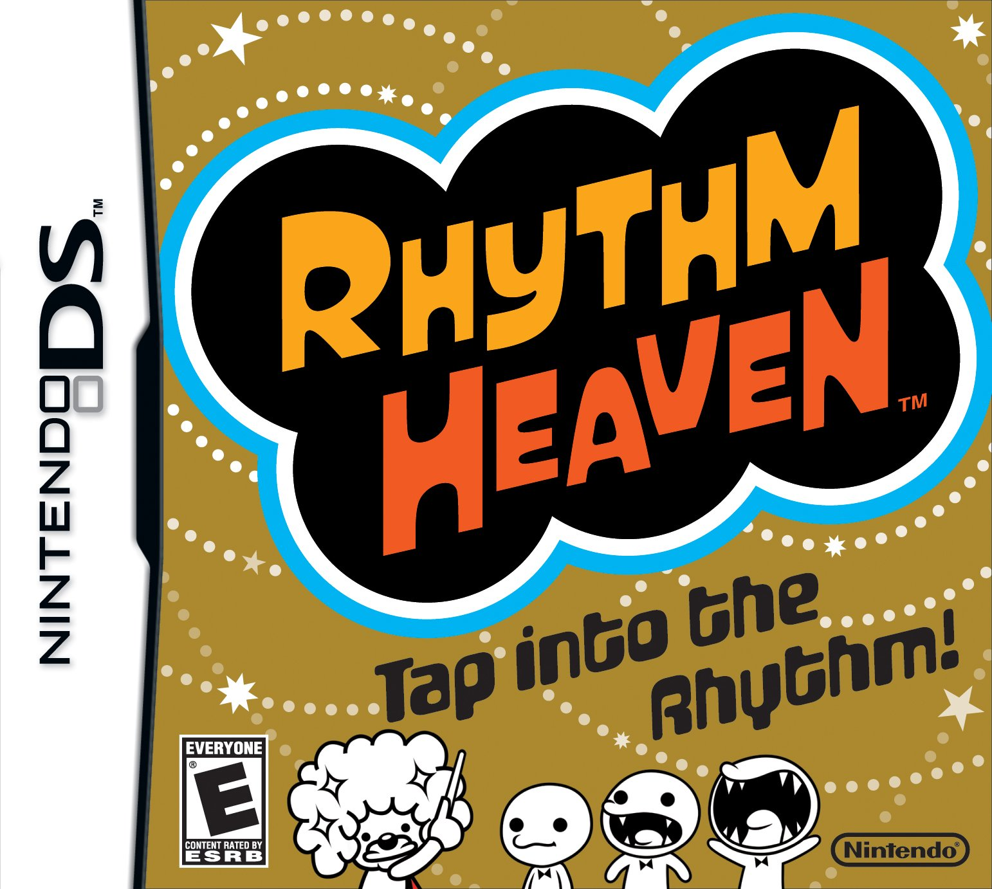
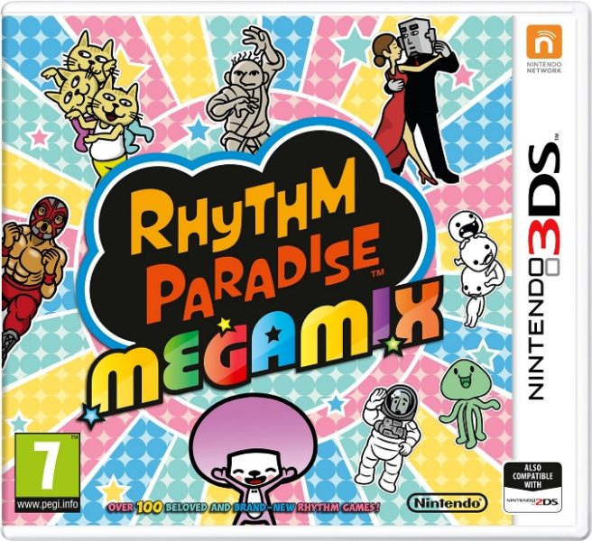

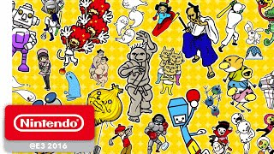
What is Rhythm Heaven?
Rhythm Heaven is a series of rhythm-based video games developed and published by Nintendo.
Players are required to input commands during the game’s musical levels, timing button presses to the beat of the music.
Rhythm Heaven Megamix - Official Game Trailer - Nintendo E3 2016 - by Nintendo of America

Slide 5
Rhythm Heaven’s levels are often short and simple, but they’re highly replayable due to them being easy to understand and hard to master.
The games challenge players reflexes and reaction times, while also being very accessible for people who aren't too familiar with video games.

Slide 6
SEAL SLAP STORYBOARD
SEAL SLAP STORYBOARD
We will take a look at a few illustrations and see how the game will be played and presented:

Slide 7


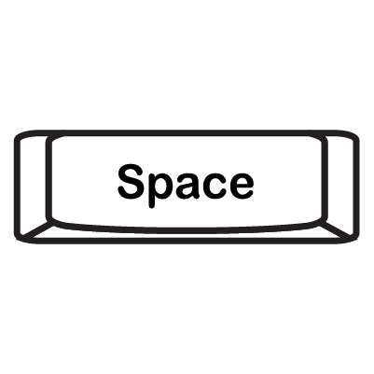
When Opening the Game…
When the player opens SEAL SLAP, they’ll be presented with the title screen.
They’ll have the option to start the game by clicking the Start Game button.
Or they can exit the game by selecting the Quit Game button.
They can select these on-screen buttons with Mouse and Left-Click, or the button’s binded key (ex; Spacebar to Start Game, Q-Key to Quit Game)
Quit Game
SEAL SLAP
Start Game
(early concept of Title Screen: )

Slide 8
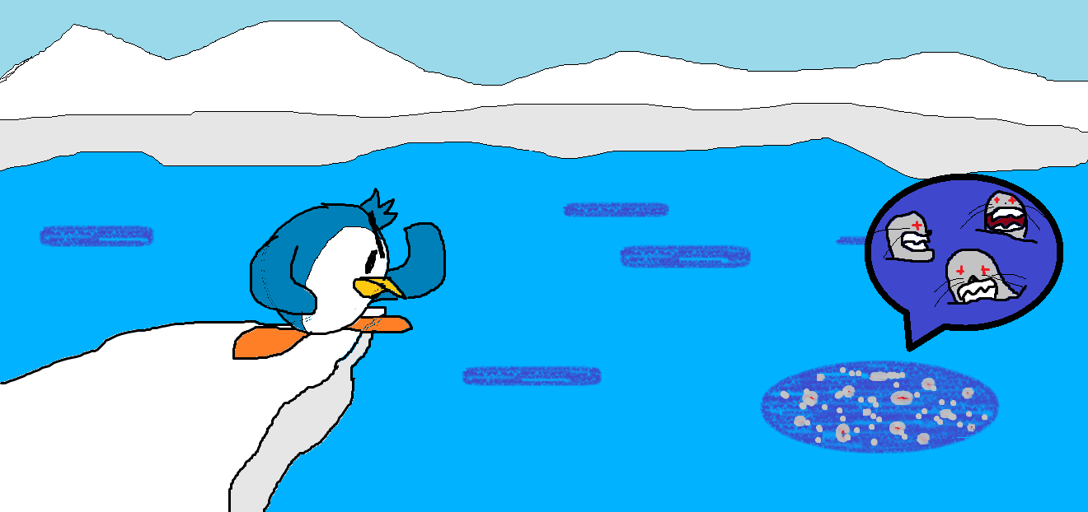
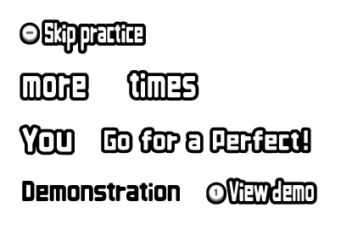
Let’s Practice!
Before the actual game begins, the player will be guided in a tutorial on how to play the game (UI text will be provided for instruction).
The player controls the penguin. They’ll first be asked to press the binded key to attack (Spacebar for keyboard).
Then repeat this action a number times.
Once they’ve met the requirement, they’ll be thrown a few practice enemies to attack at. They must complete a number of sets to pass the tutorial. A metronome will provide an audible click to help players time their attacks.
3 enemies = 1 set

Slide 9
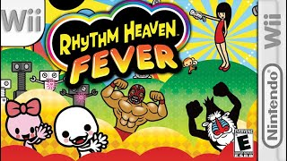
Here’s an example:

Slide 10
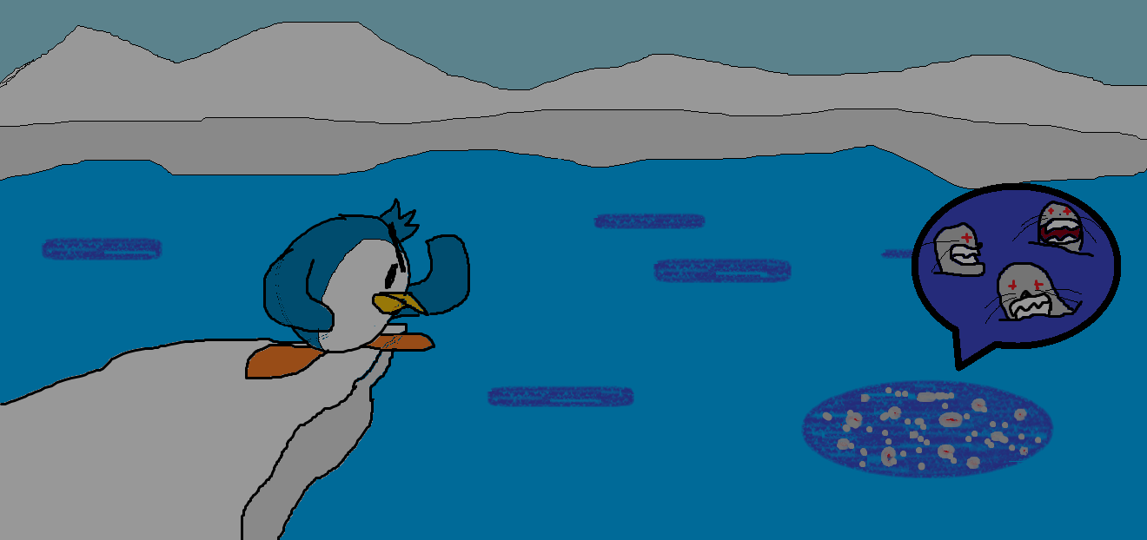
If the player wishes to skip the tutorial, they can select the Skip Practice button with Mouse and Left-Click, or pressing the - Key.

Slide 11
Let’s Begin!
Music will start playing, and the enemies will begin to attack. The player must listen to the beat of the music, watch for enemies, and time their attacks.

Slide 12
Here comes an enemy…
“1!”
An enemy jumps from the background…

Slide 13
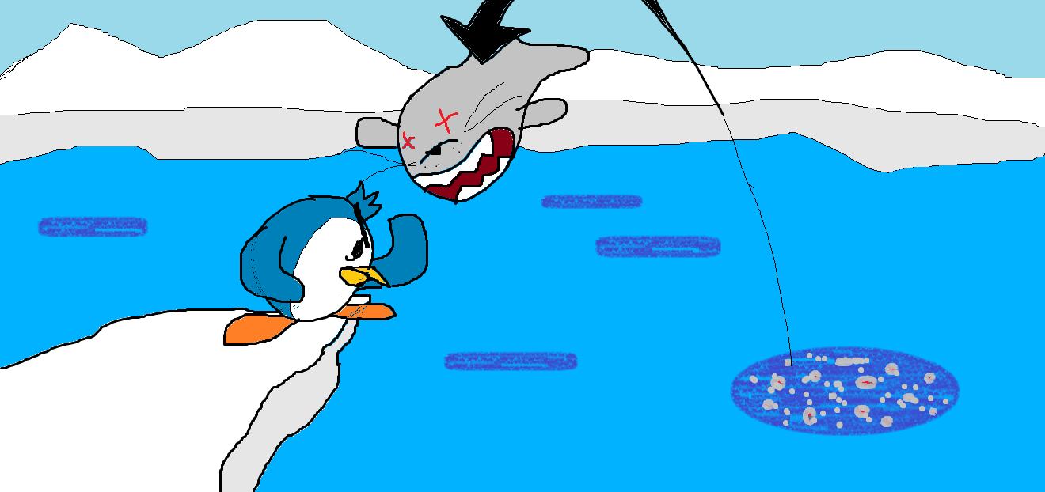
This is the window to strike!
“2!”
The enemy approaches the player. Timed to the beat of the music, the player should press the appropriate key (Spacebar) and strike back before the enemy does!

Slide 14
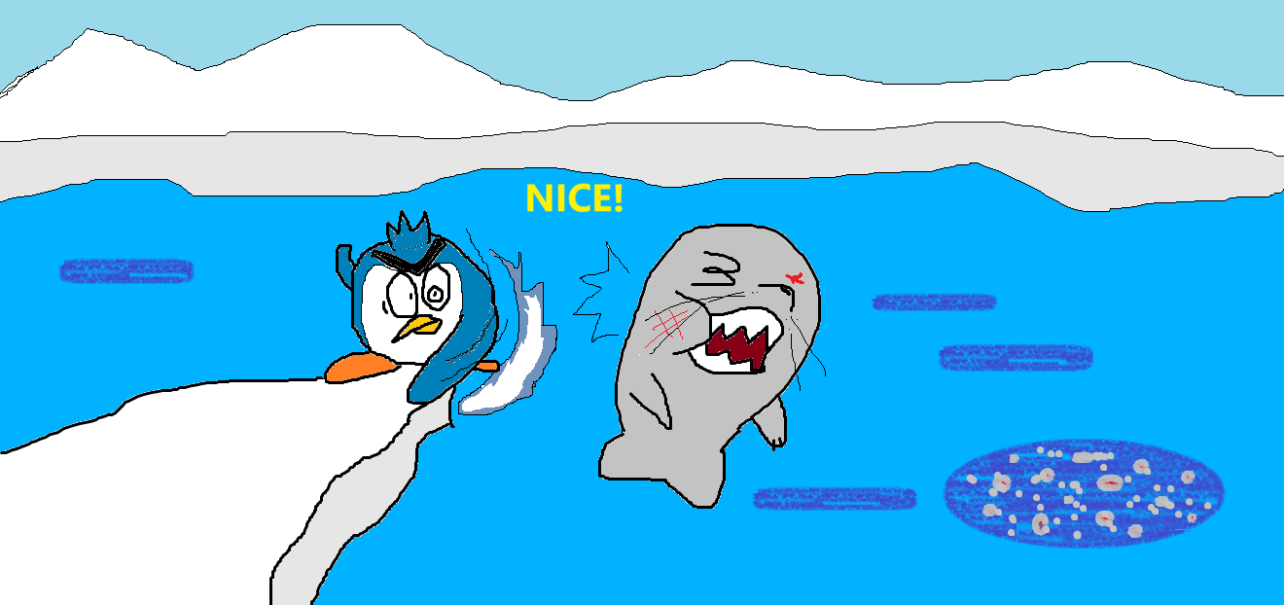
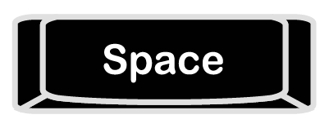
POW!
“3!”
If timed correctly, the player lands a hit on the enemy and the provided UI will inform the player if they timed their attack early, correctly, or late.
If the player misses, the player will lose points.

Slide 15
Finish the song!
More enemies will attack and at different times to confuse the player. Listen to the music, listen to the beat, and time your reactions carefully!

Slide 16
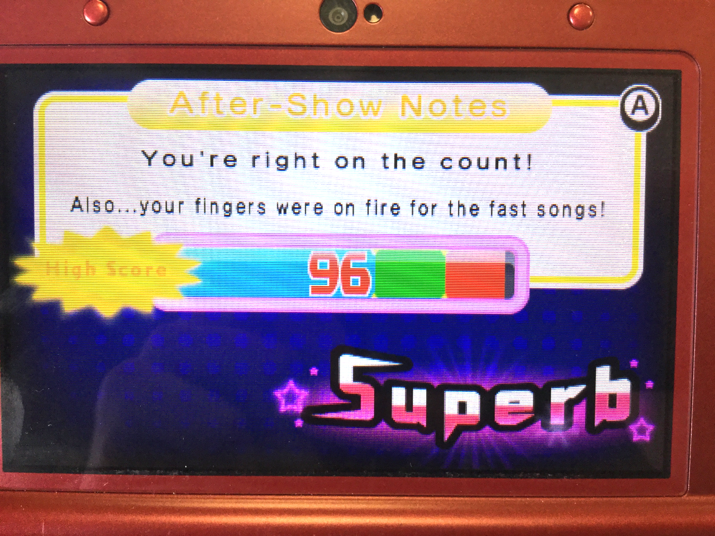
End?
The player will receive a final grade based off their score. They’ll be asked to press the Play Again button, or to Quit Game.

Slide 17
THANK YOU!
THANK YOU!

